Slide 1
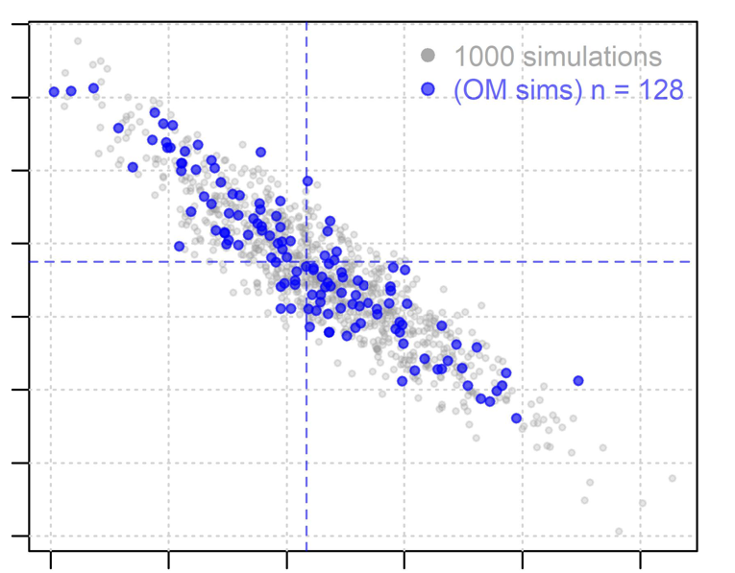
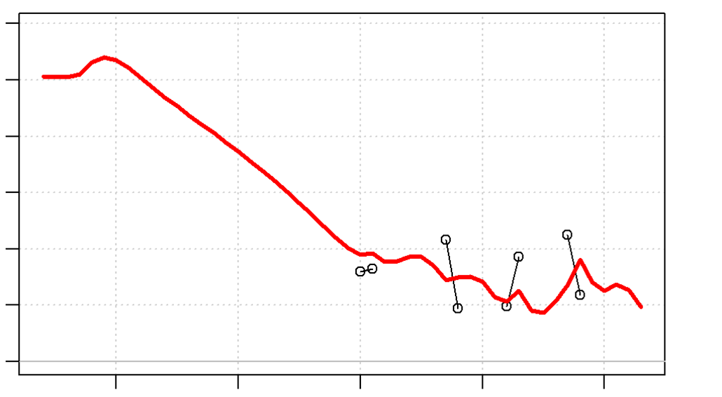
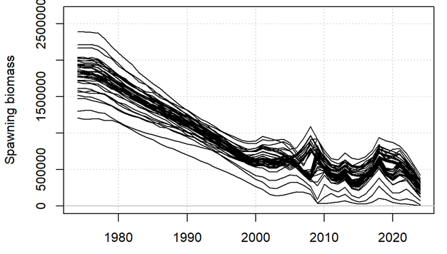


Developing A Framework for Management Decision Making for the Tasmanian Sand Flathead Fishery
Deliverable 1: Straw dog operating models
Tom Carruthers
29th March 2024, Online, Blue Matter - UT

Slide 2
Contents
Resources
Input data
Model input parameters
Assumptions
Model fit
Model estimates
Next steps in OM / MSE development

Slide 3

1. Resources: Project Splash Page
http://sandflathead.bluematterscience.com
Project info
Background documents
Progress / priorities
Analyses
Example code
Results
Reports
Links

Slide 4
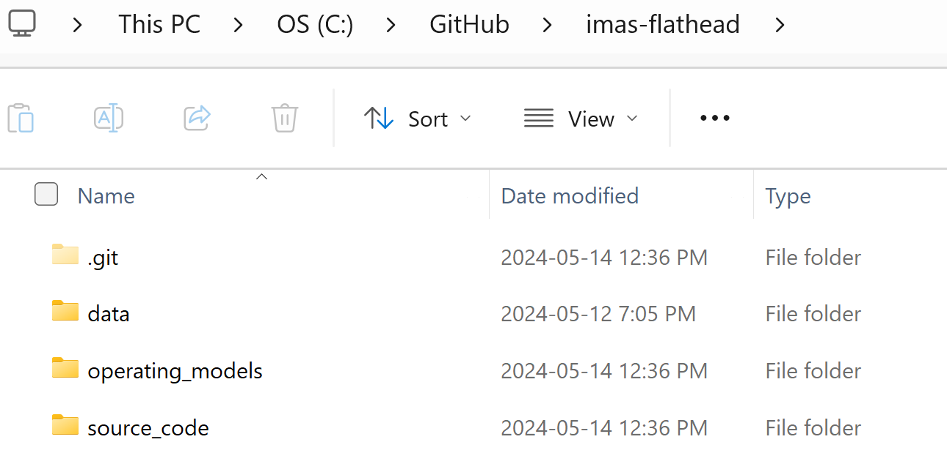
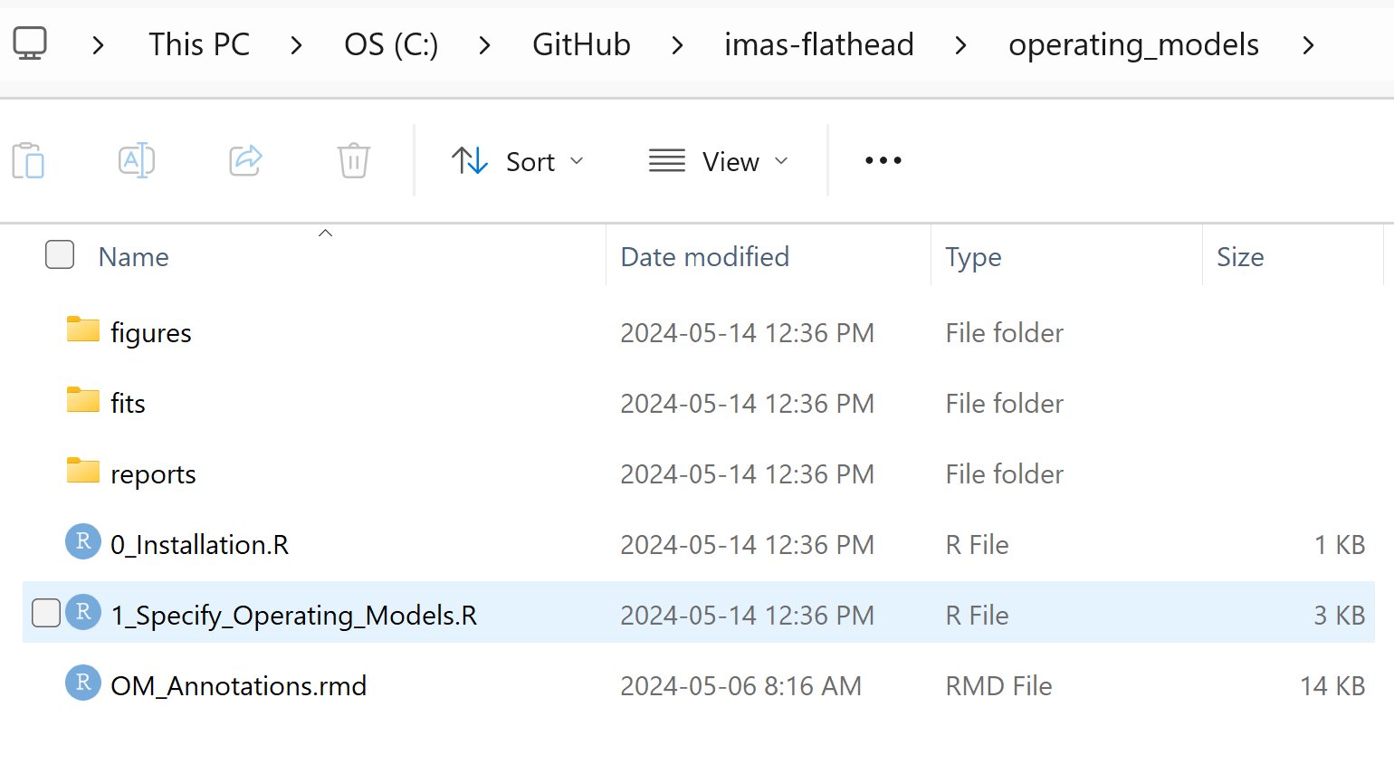
1. Resources: GitHub repository
https://github.com/bwwolfe/imas-flathead
/source_code has all the nasty internal functions.
/operating_models has the higher level scripts for installation and OM construction (i.e., the ones you would look at first before delving into the source code).
The first place to go would be the ordered scripts in this directory.

Slide 5
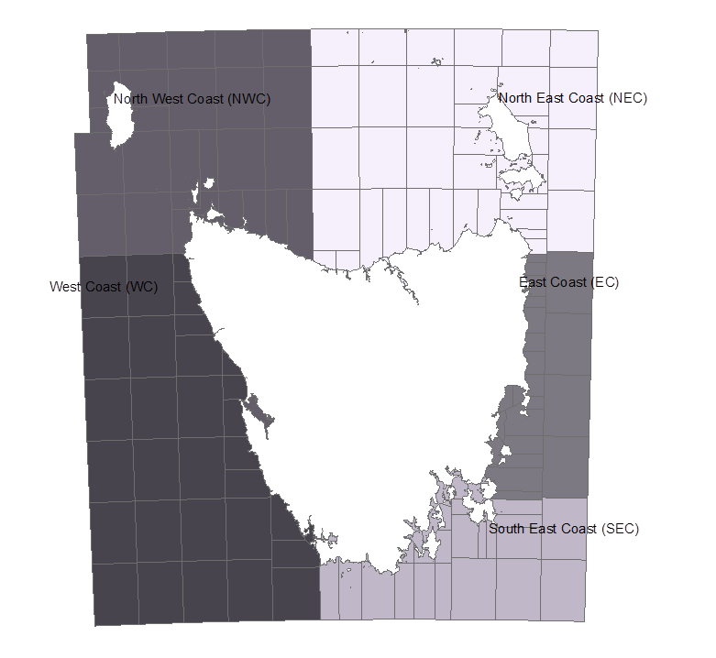
2. Input data: Spatial definitions
Used the lowest common denominator across data-sets (‘Large region’):
SEC: Derwent Estuary, Tasman, Frederick Henry/Norfolk Bay, South-eastern coast, D’entrecasteaux Channel, South, Northwest Bay, SECest, SEC
EC: Great Oyster Bay, Central-eastern coast, Eastern coast, Coles Bay, Georges Bay, EC
NWC: North-western coast, King Island, rocky cape, NWC
NEC: Tamar River, North-eastern coast, Flinders Island, Spring Bay, Flinders/Eastcoast, NC, EC, Deal island, Hogan group, NEC, FI
WC: Central-western coast, Western coast, South-western coast, unknown EAT, ECS, ET, SET, CBS, no sample

Slide 6
2. Input data
Model needs either complete (all years) catch or complete effort time series (can assume mean ‘spool-up’ catch)
Recreational catch (patchy)
Recreational effort (patchy)
Standardized recreational CPUE index
Historical survey age / length composition
Recreational survey age / length composition
Commercial catch (not WC)
Commercial effort (not WC)
Nominal commercial CPUE

Slide 7
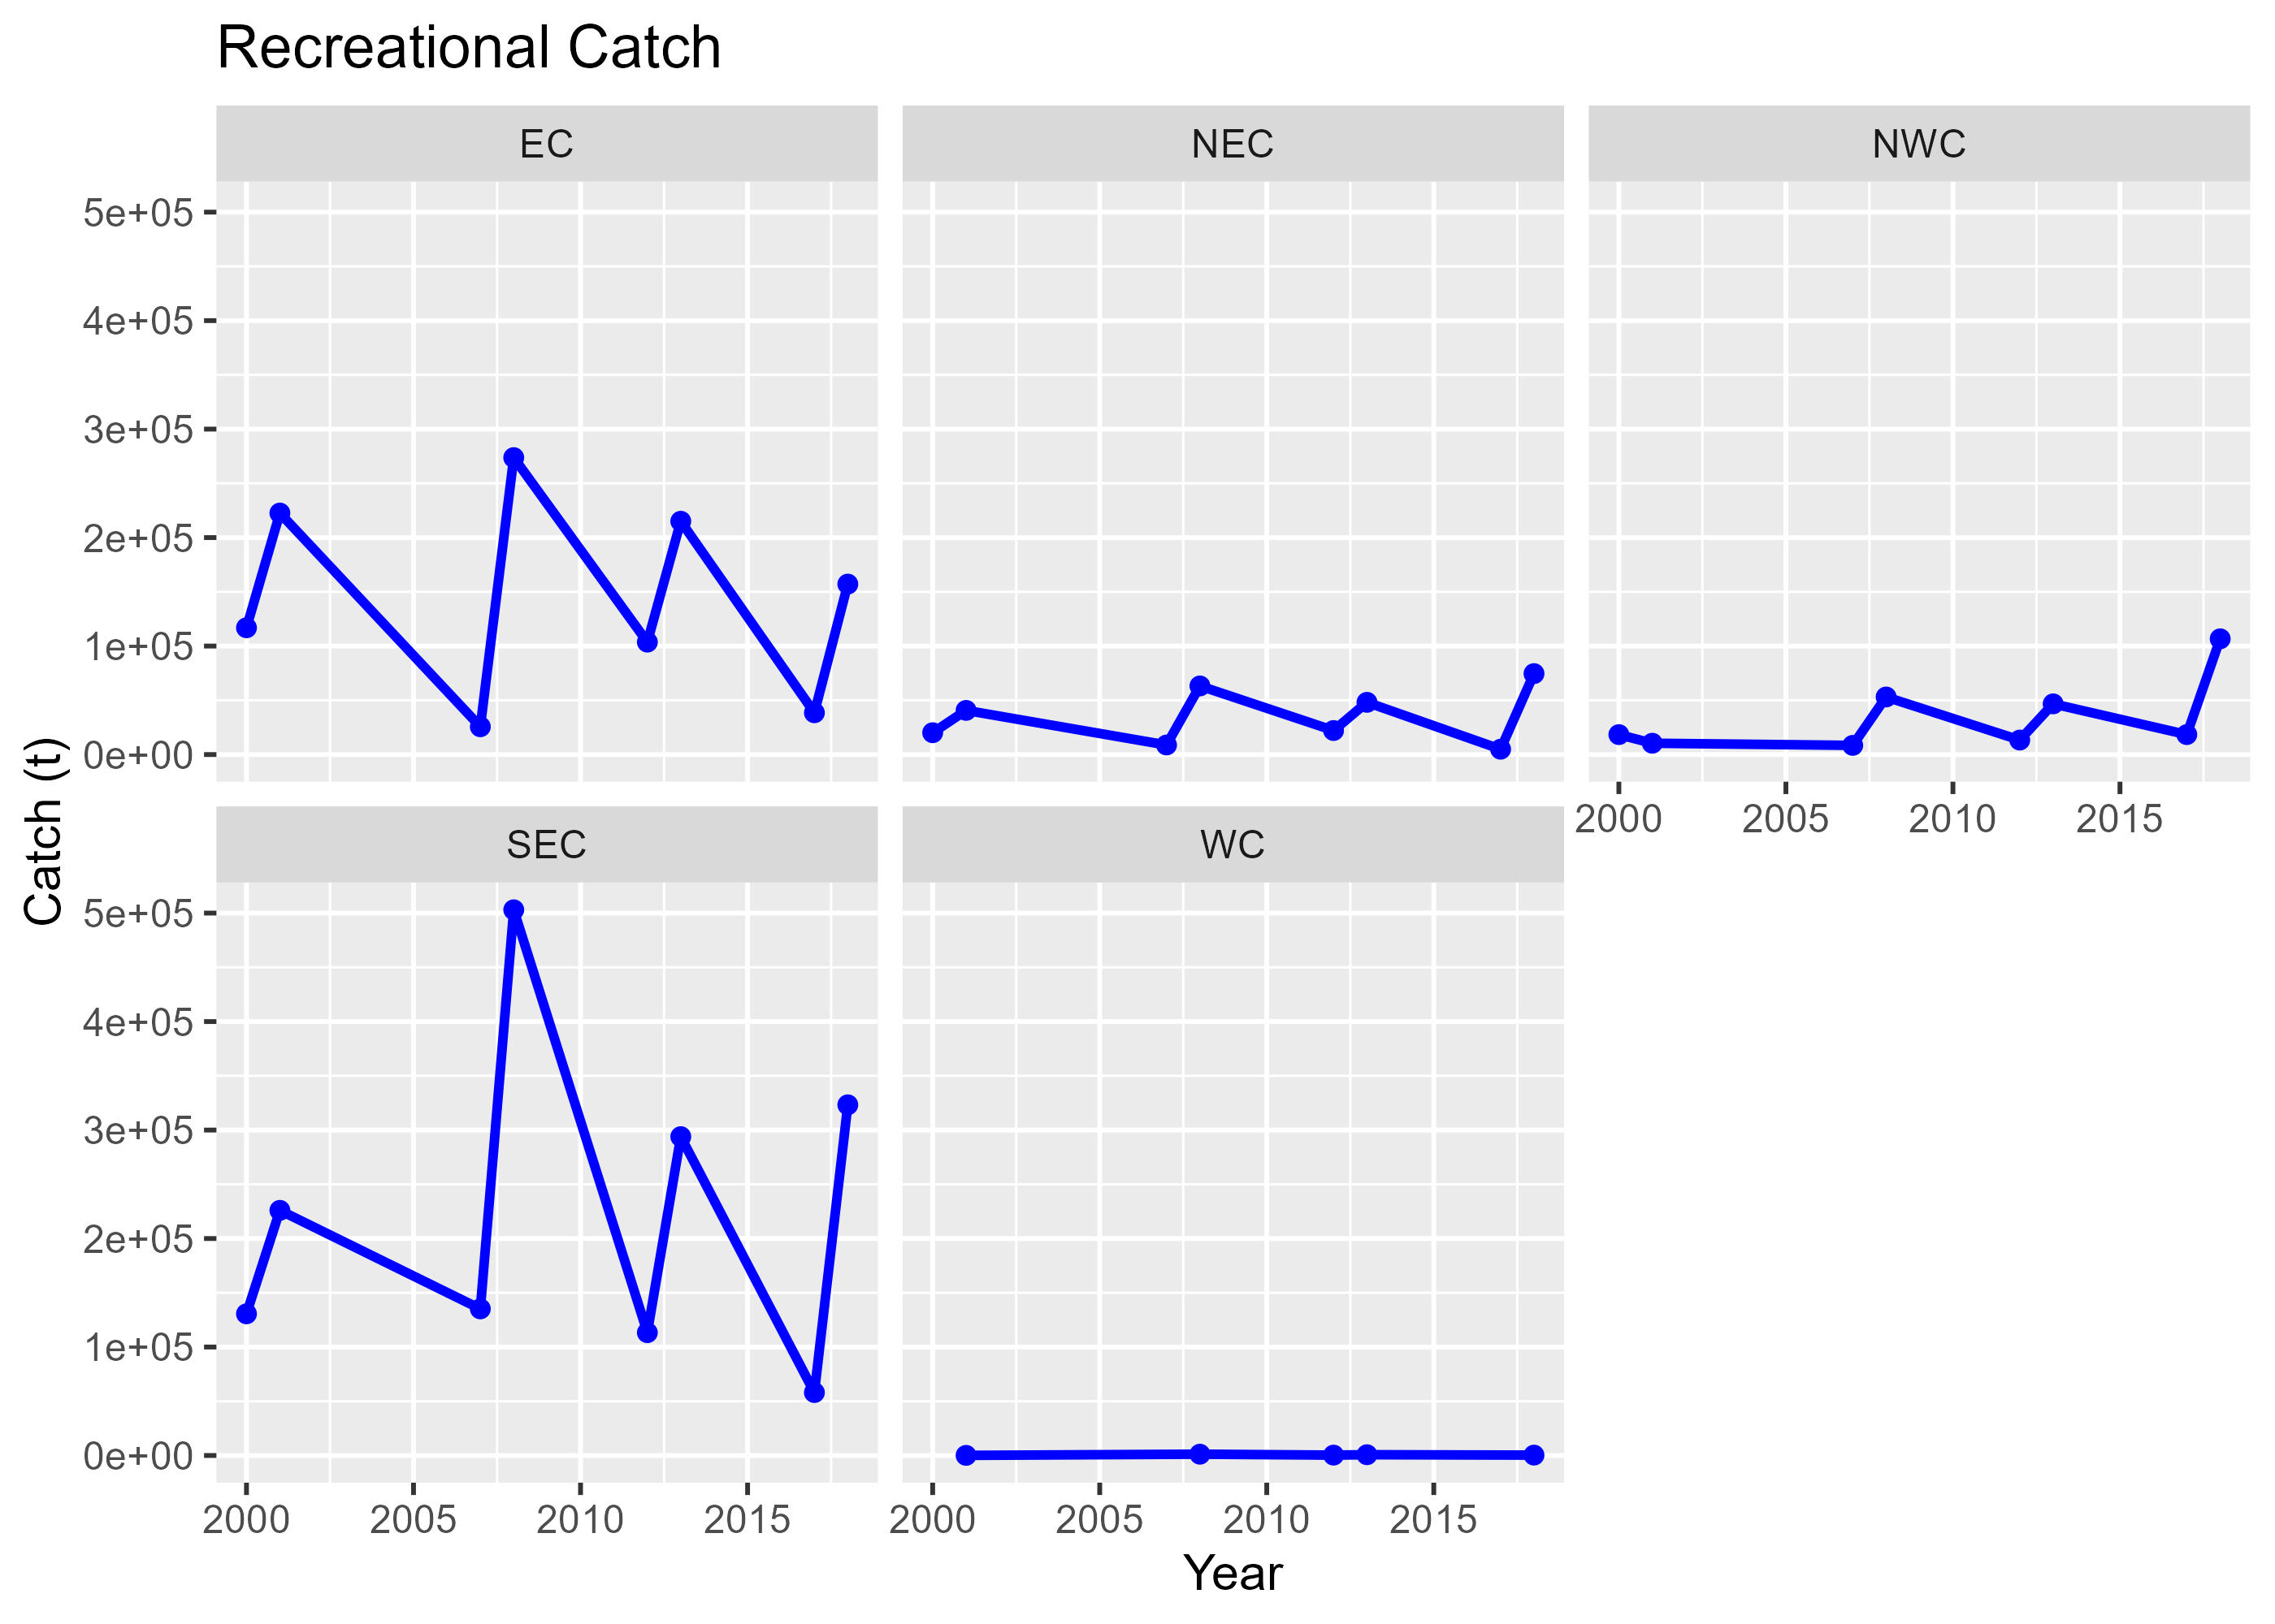
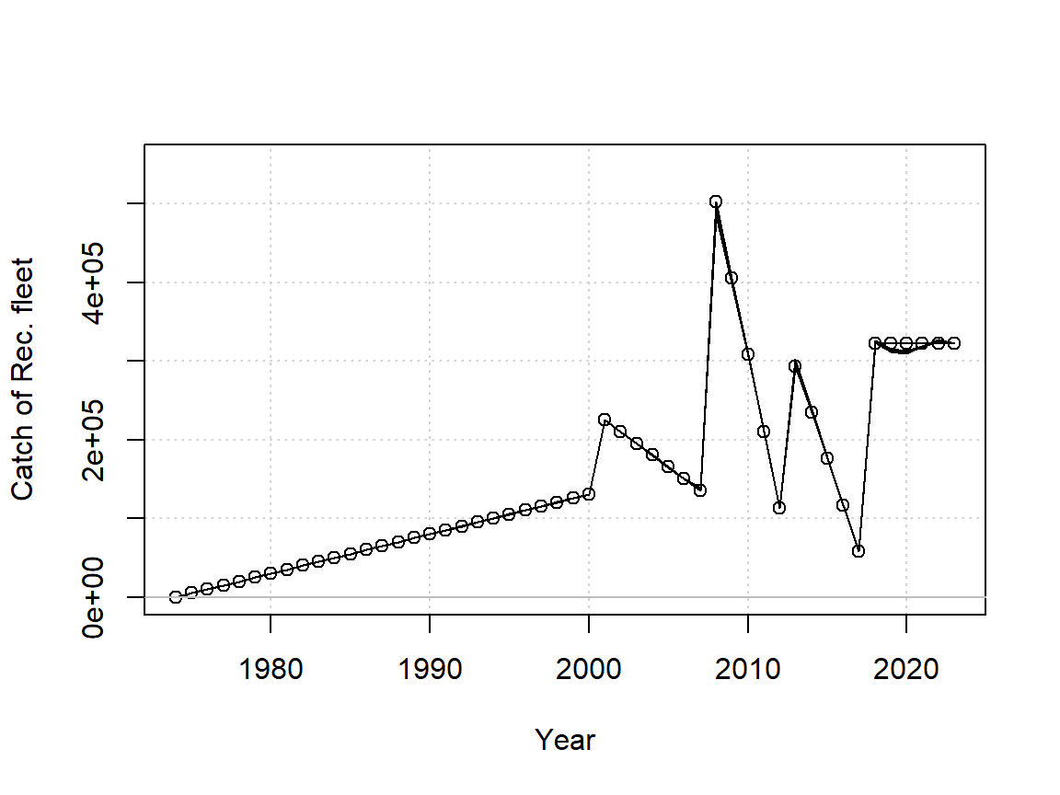
2. Input data: Recreational catch
! Linearly ramped to first observation !
SEC
! Linearly interpolated !
Annual data available?
Start date for OM spool up – or mean catch prior to 2001?

Slide 8
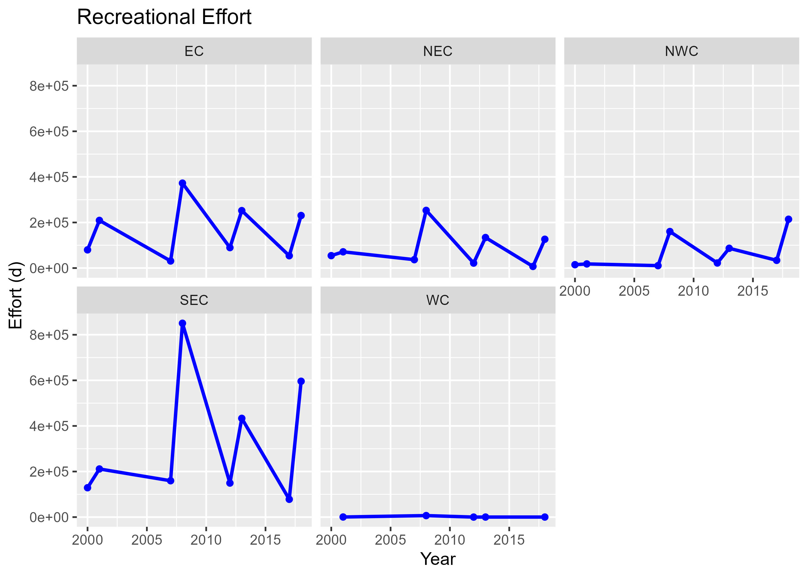
2. Input data: Recreational effort
Not currently used - the standardized CPUE is used instead.
! Linearly interpolated !
Conditional on effort approach??

Slide 9
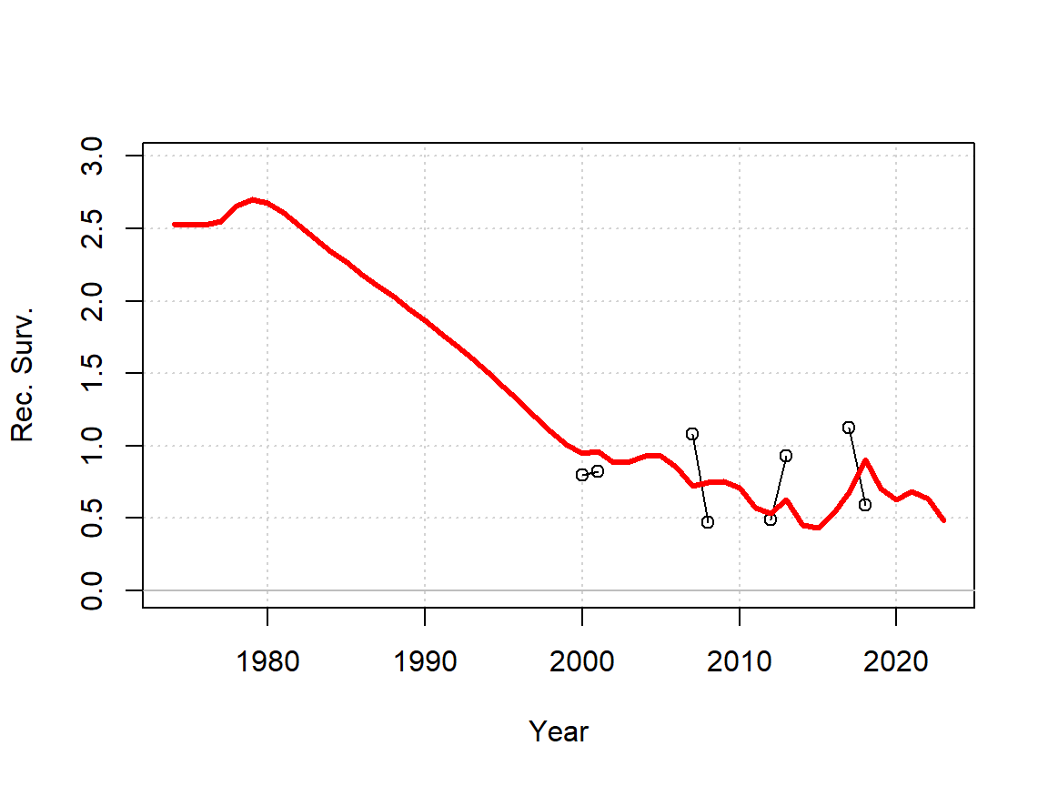
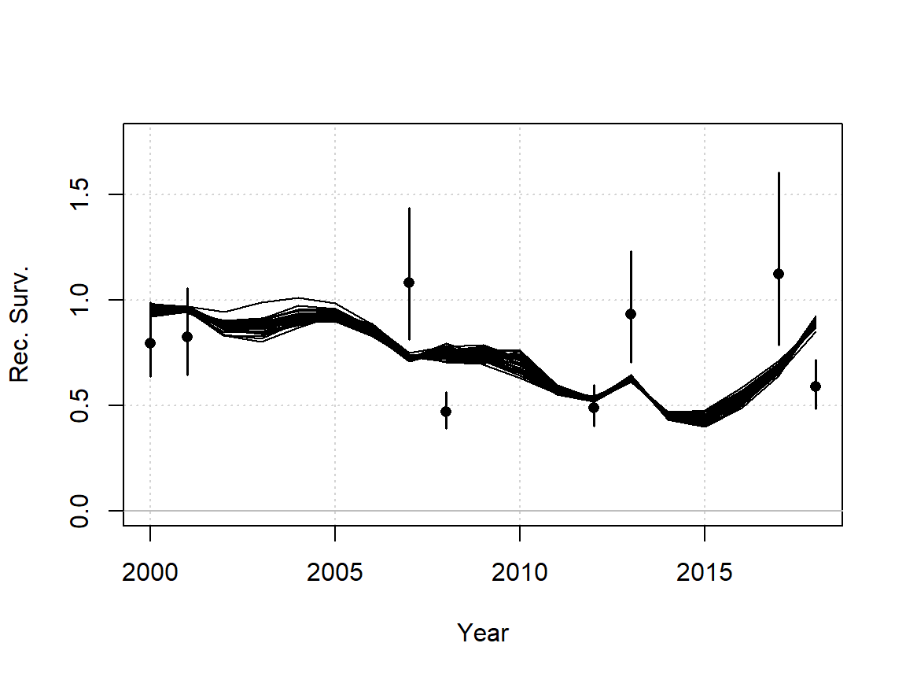
2. Input data: Standardized CPUE indices
log(CPUE) ~ Yr + Quarter + Region + WaterBody + Type
SEC
‘Region’ is something like Tasman, Derwent Estuary etc.
Standardized CPUE
OM model fit
Note that most of these indices still include apparent discontinuity in adjacent ‘observations’ both nominal and standardized. The model can’t get through these even with substantial error bars

Slide 10
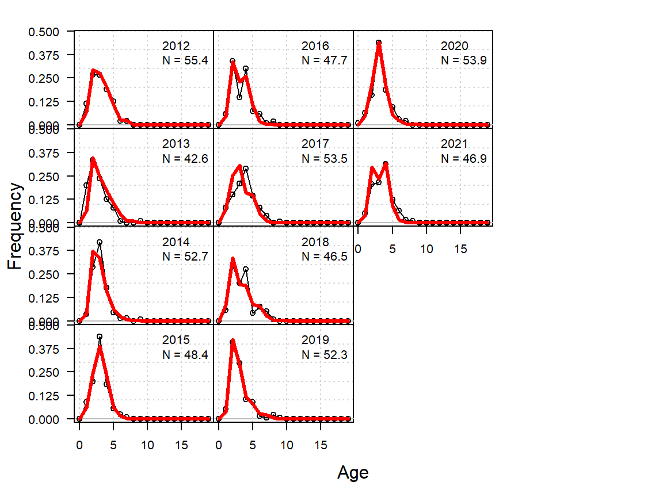
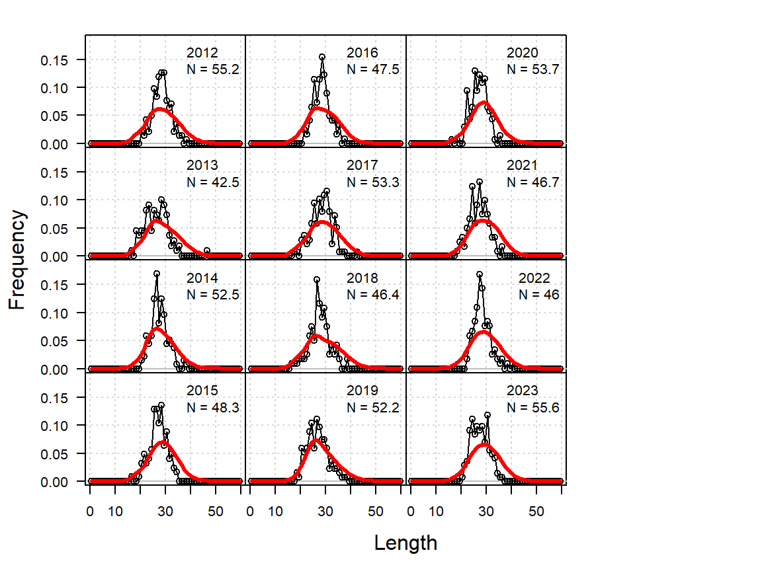
2. Input data: Recreational Survey (length and age)
Observed data
OM model fit
SEC
SEC
Is this indicative of recreational fishery selectivity?
rec_survey_data_20231215.xlsx

Slide 11
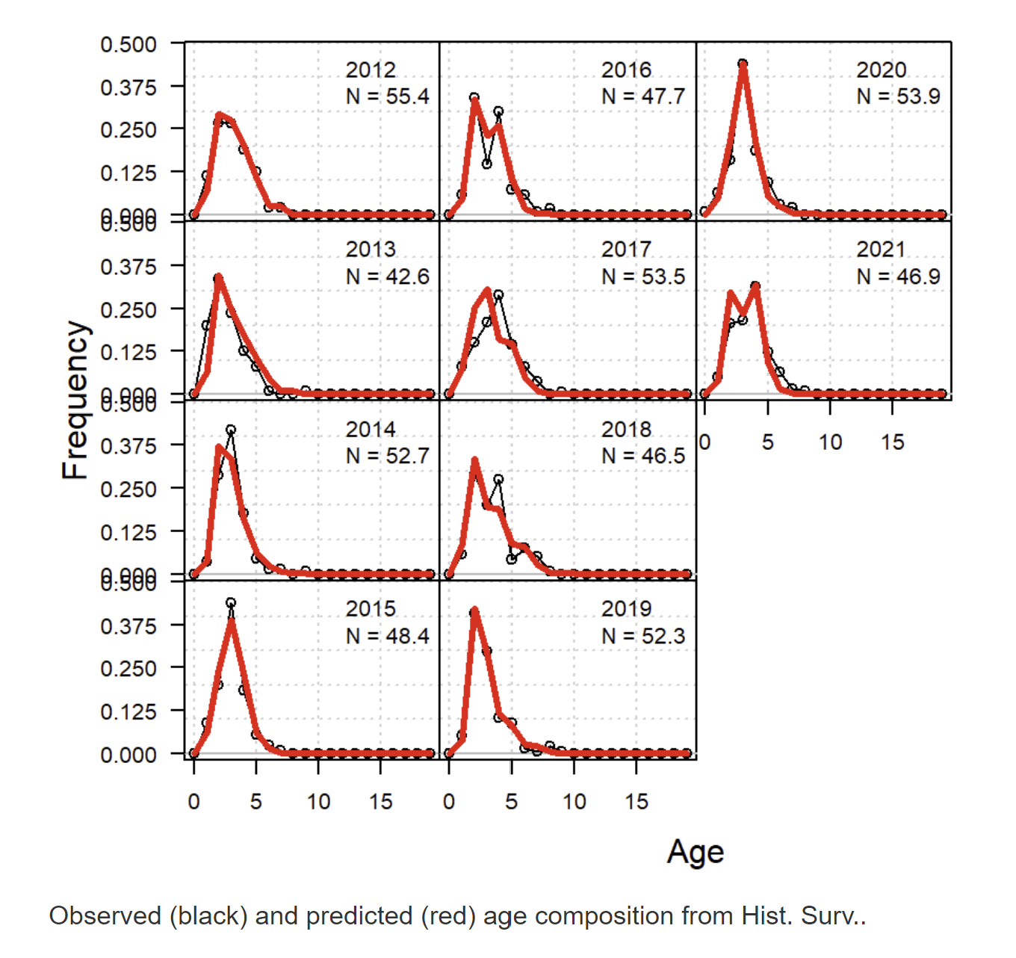
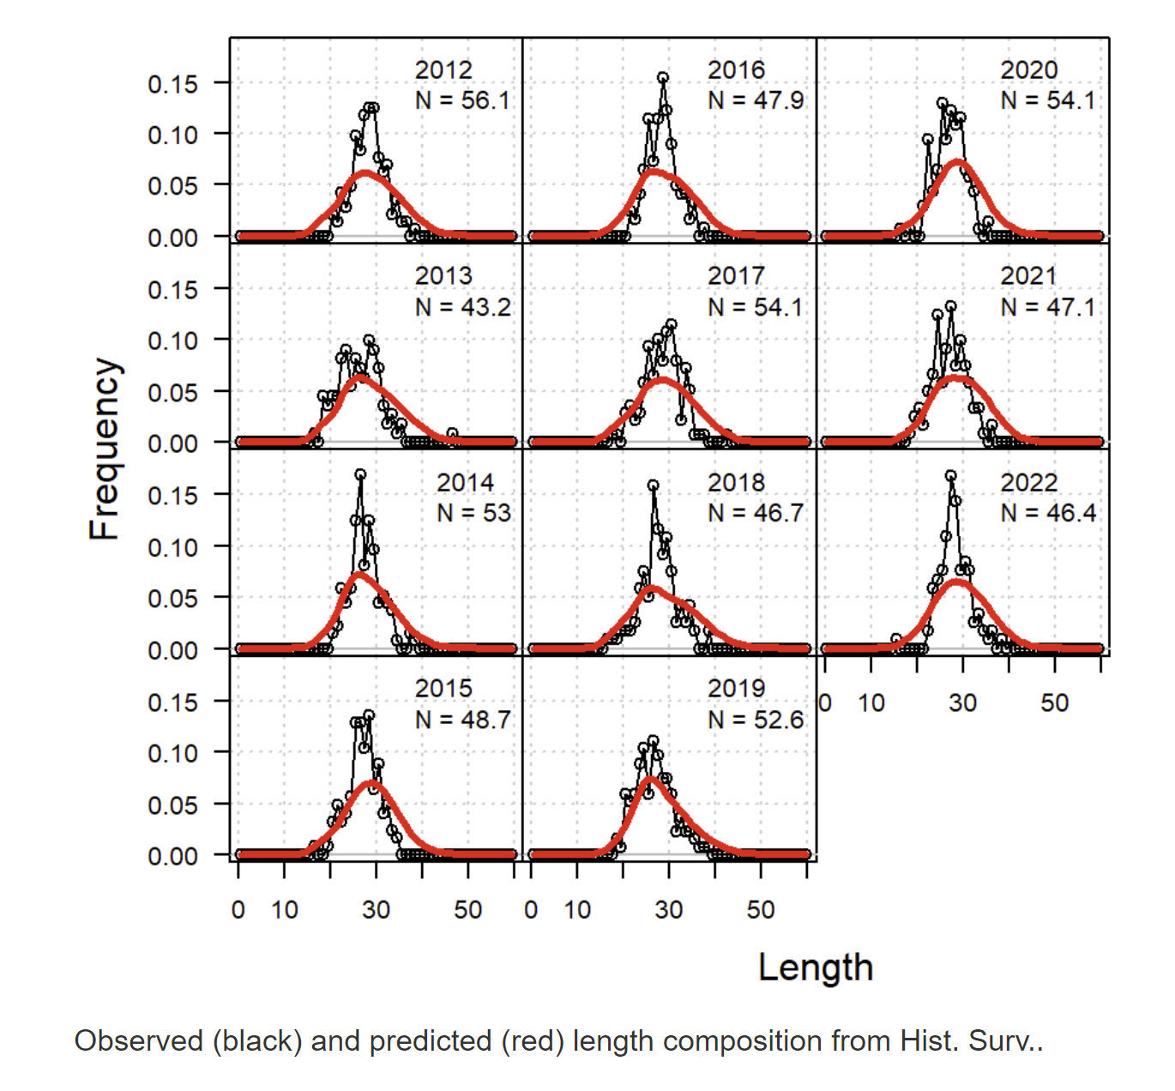
2. Input data: Historical Survey (length and age)
Observed data
OM model fit
Is this indicative of recreational fishery selectivity?
SEC
SEC
historical_data.xlsx

Slide 12
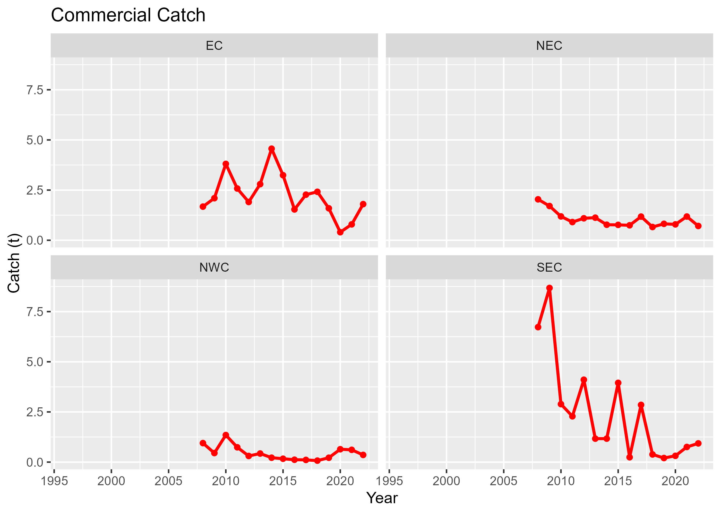
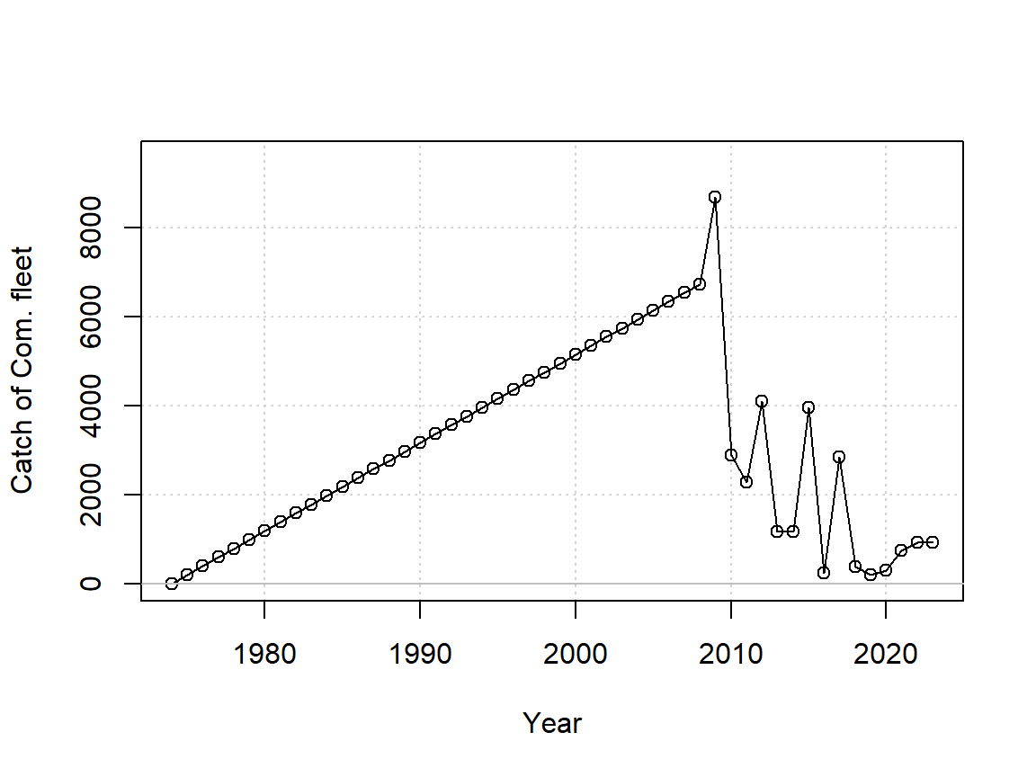
2. Input data: Commercial catch
! Linearly ramped to first observation !
SEC
Start date for OM spool up – or mean catch prior to 2008?
southern_sand_flathead_catch_tonnes_by_region_BMS.csv

Slide 13
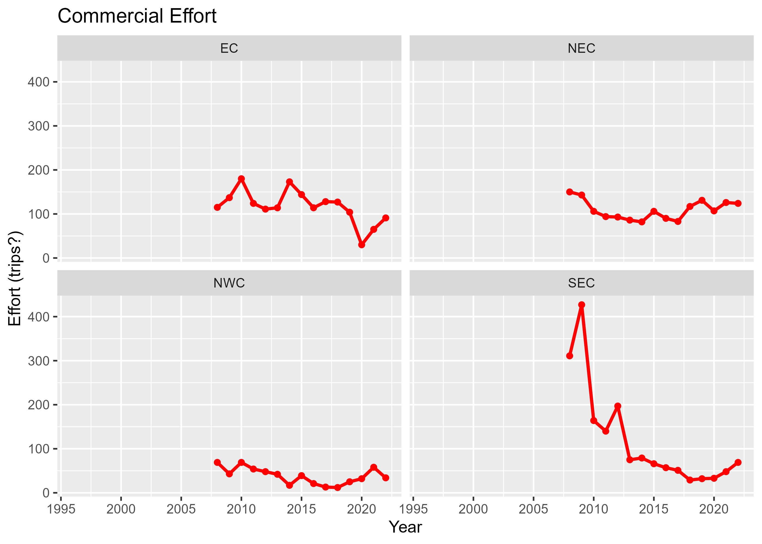
2. Input data: Commercial effort
Not currently used – nominal CPUE index used instead.
southern_sand_flathead_vessel_days_by_region_BMS.csv

Slide 14
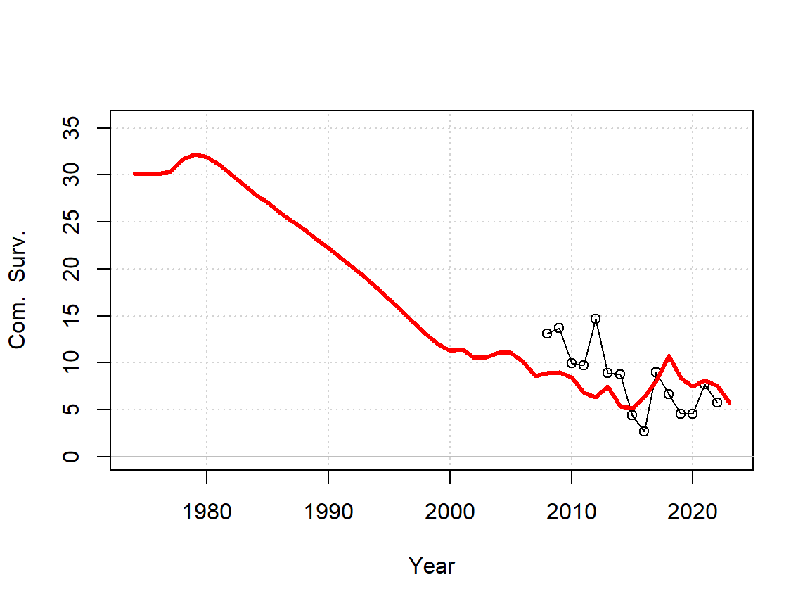
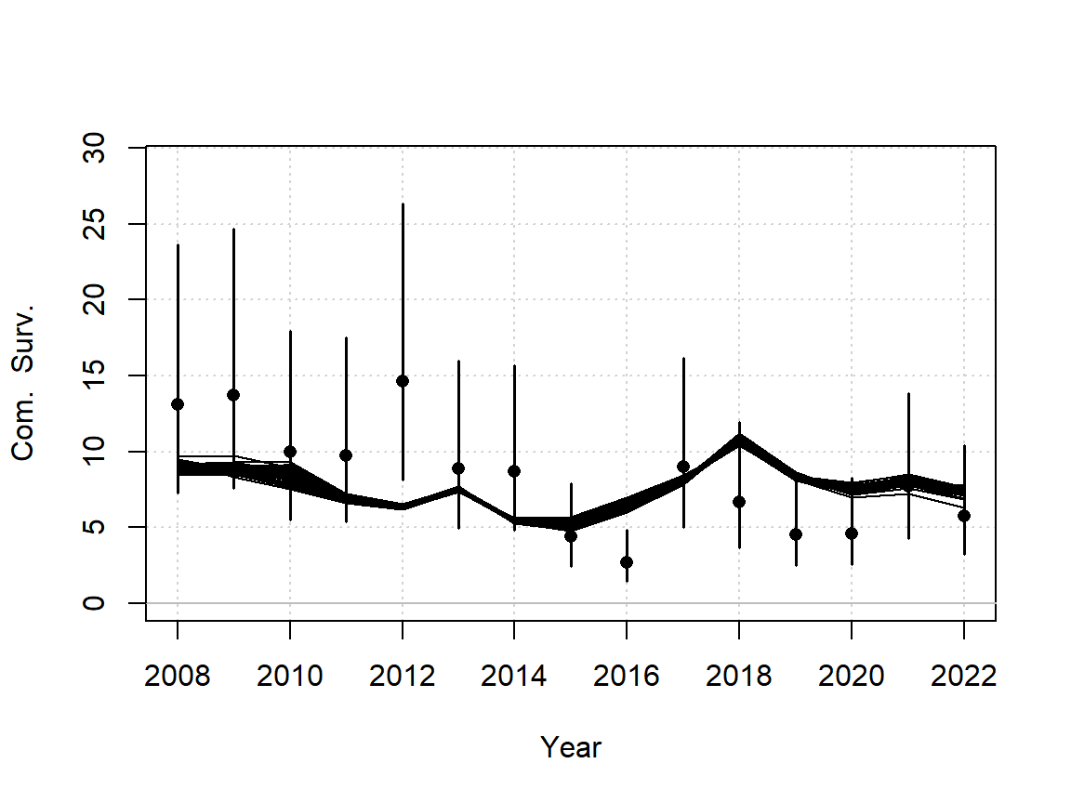
2. Input data: Commercial nominal CPUE
Nominal CPUE
OM model fit
Vague – high observation error assumed (40% CV)
southern_sand_flathead_cpue_kgperday_by_region_BMS.csv

Slide 15
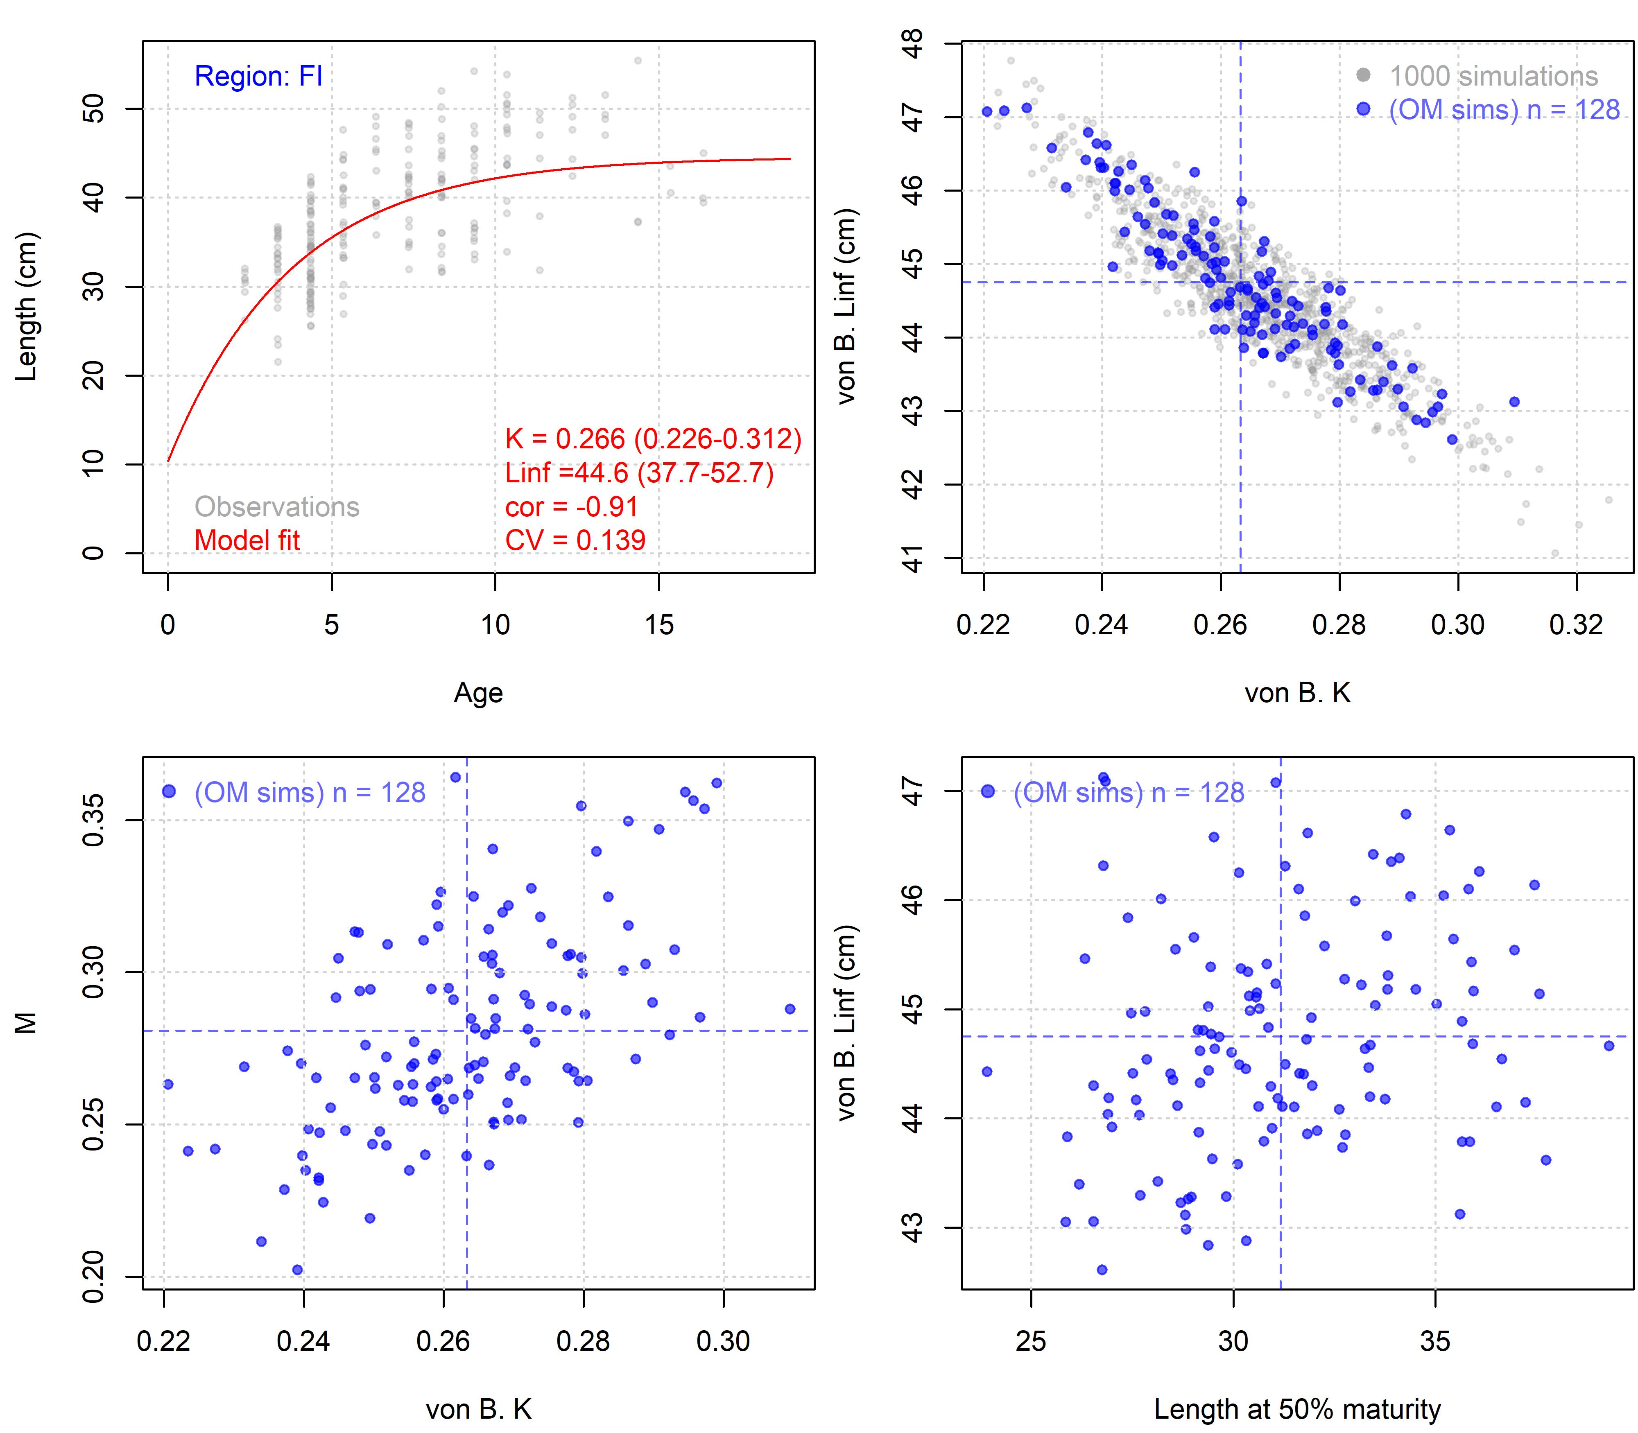
3. Model input parameters: Somatic growth
Used Flinders Island data as the ‘unfished’ level for K, Linf parameters.
Maintained correlation in estimates, used FishLife meta analysis to preserve correlation in sampled natural mortality rate and length at 50% fraction mature.
Should we be using Flinders’ data for this in all regions?
Estimated asymptotic length (Linf) lower than that used in other analyses.
sfh_fishery_independent_data.xlsx

Slide 16
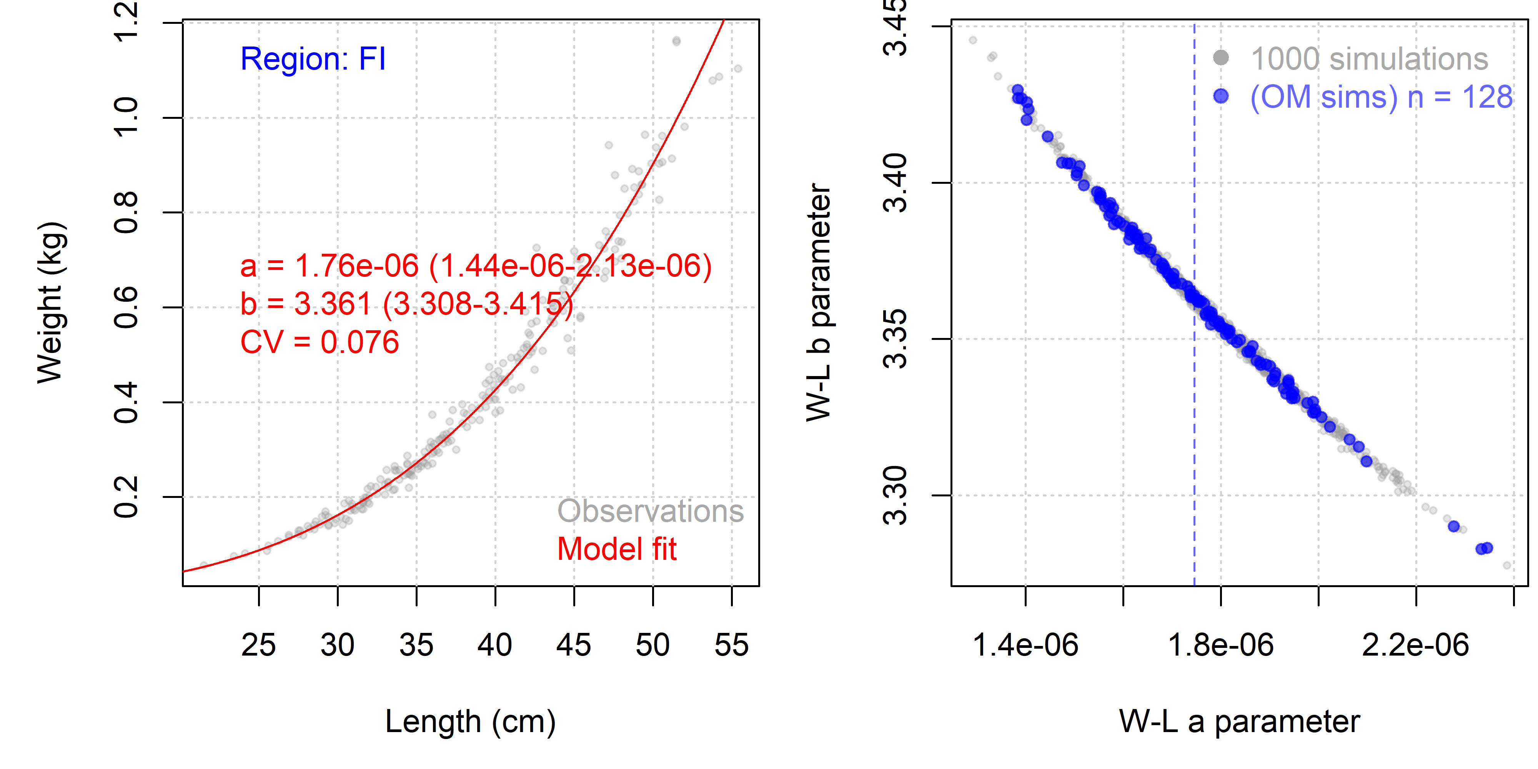
3. Model input parameters: weight at length
Used Flinder’s data – is that correct?
sfh_fishery_independent_data.xlsx

Slide 17
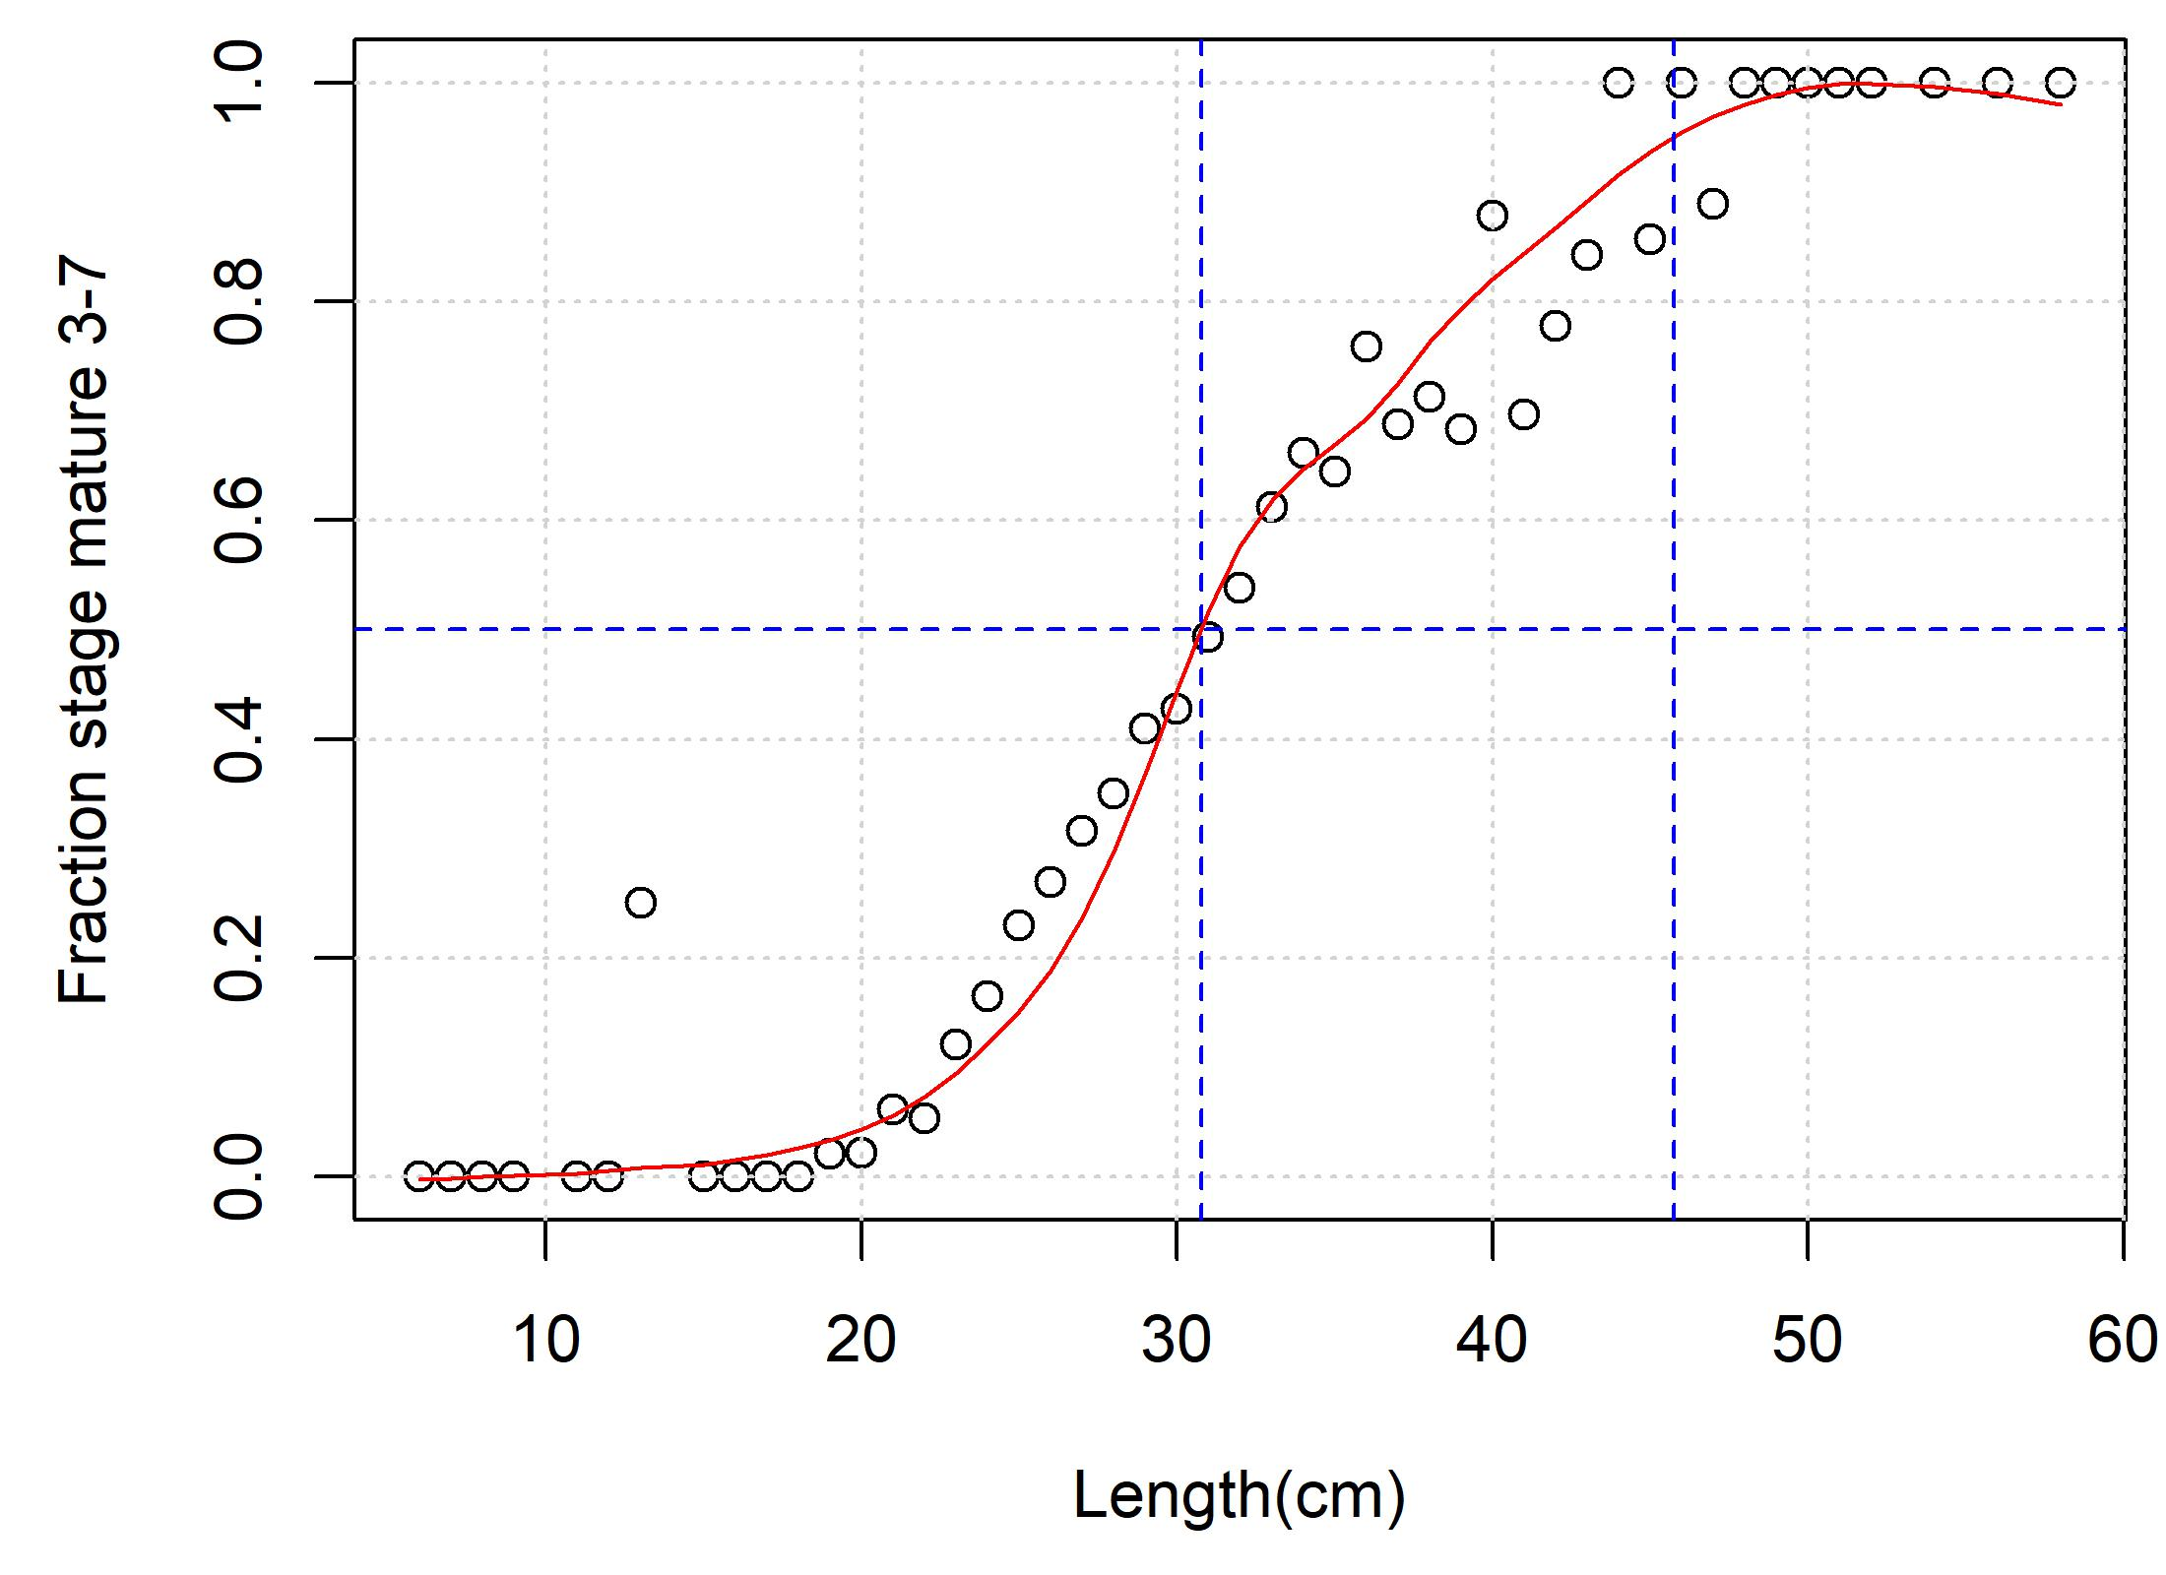
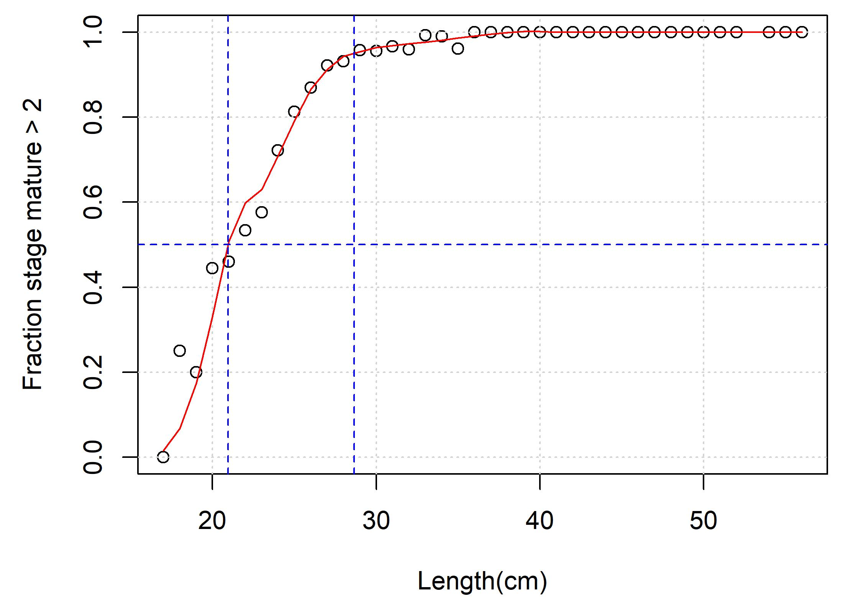
3. Model input parameters: maturity
historical_data.xlsx
Rather different maturity ogives depending on data source!
What maturity data / ogive to use?
sfh_fishery_independent_data.xlsx

Slide 18
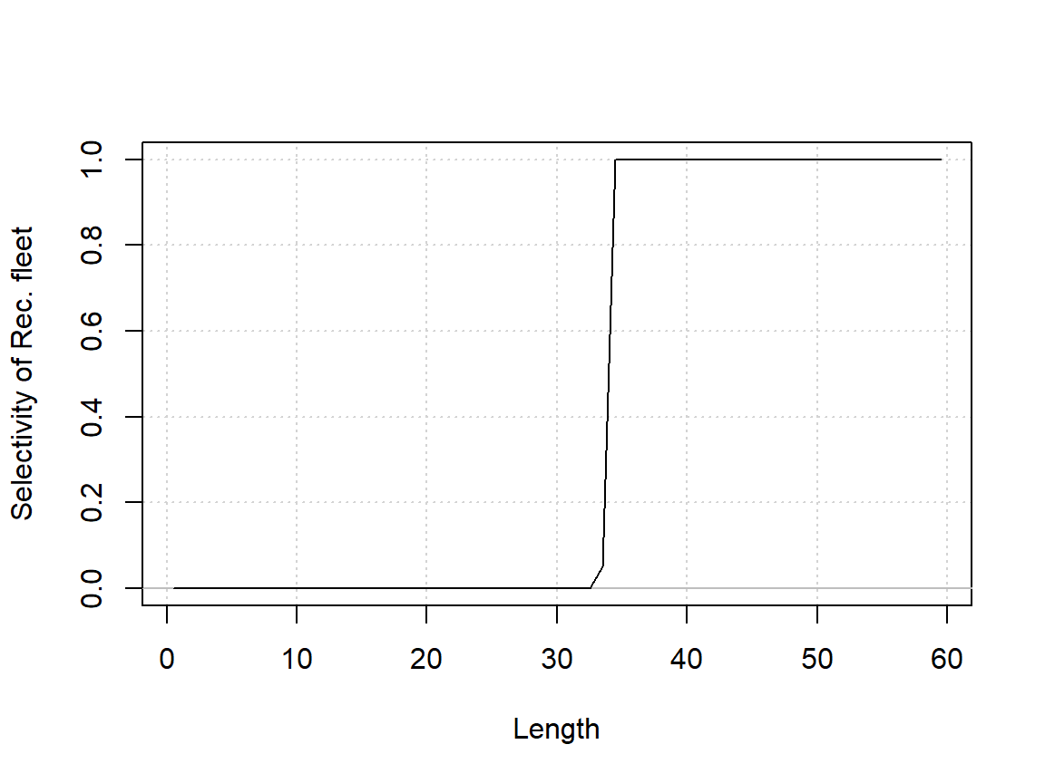
3. Model input parameters: recreational / commercial selectivity
Currently knife edge at ~34cm
Should this mirror the selectivity estimated for the historical or recreational survey?

Slide 19
4. Assumptions
Interpolation / ramping of catches (models conditioned on catch)
Rec survey / hist survey not connected to rec selectivity
Rec selectivity eyeballed currently and assumed asymptotic (flat topped)
FI life-history parameters are appropriate for other regions
M is 0.28 with CV of 0.15
No background rate of discarding
Models arbitrarily started in 1974
No uncertainty in catches which are calculated from point values of expansion factors
Discard mortality rate is 9% (Lyle et al 2006)
Year vs season – calendar year is later half (Season 2022/23 is assigned year 2023)
Commercial selectivity / retention at age / length is same as rec fleet
Composition data assumed to have mean effective sample size of 50 per year.

Slide 20
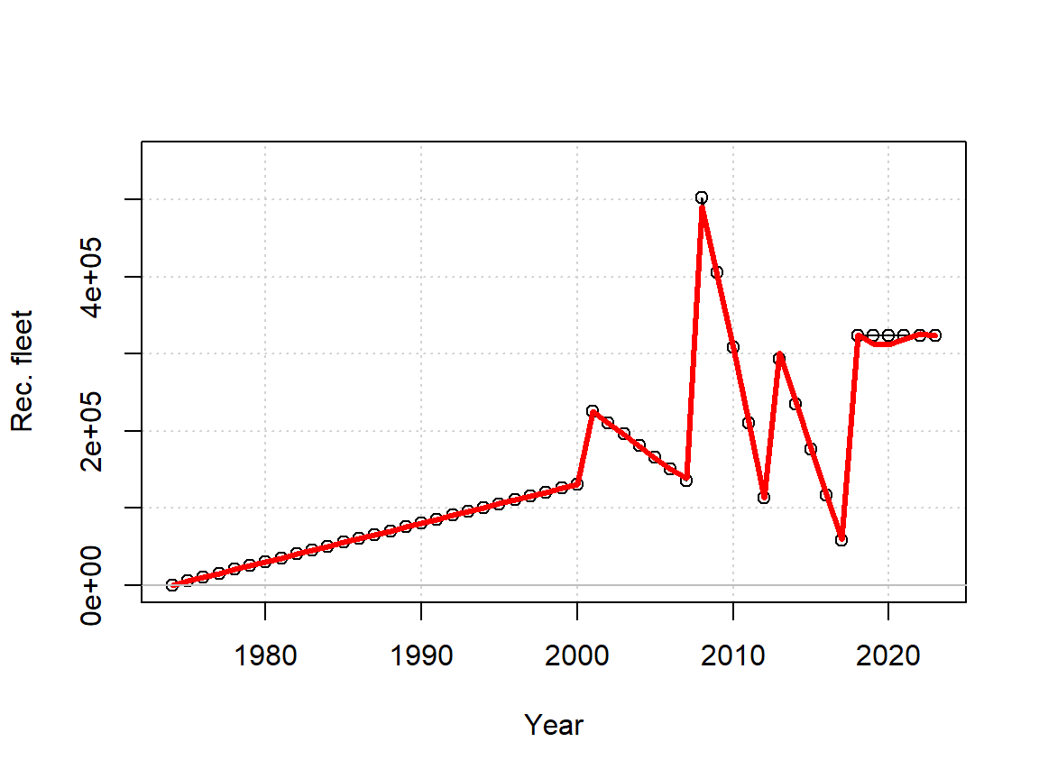
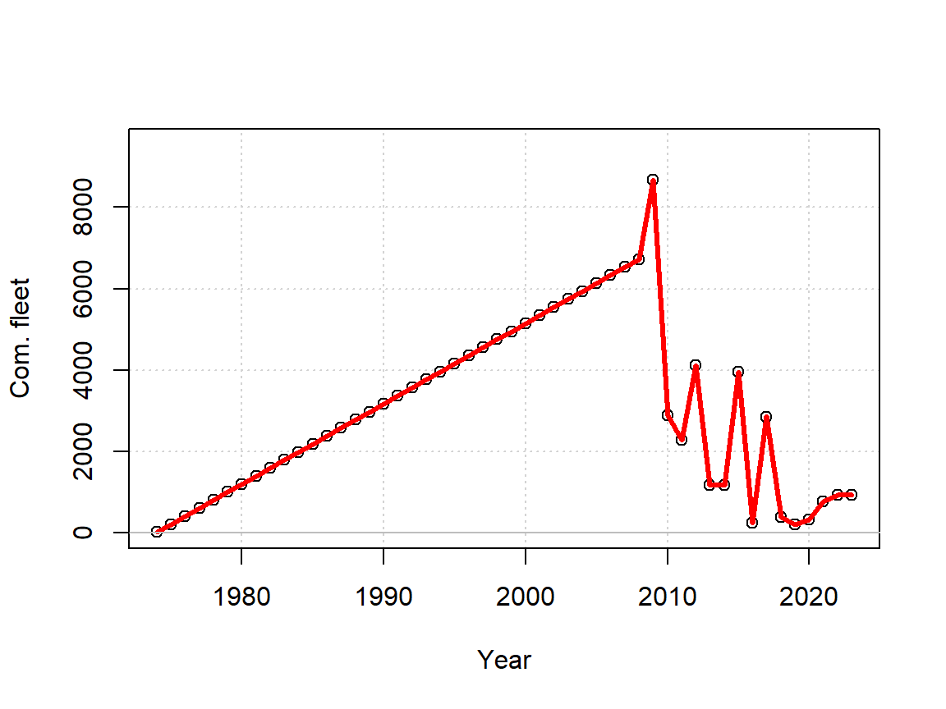
5. Model fit (SEC): Catches
Observations
OM model fit
Recreational
Commercial
How can historical catches be reconstructed?
How can recent catches be interpolated?
Can uncertainty in historical catches be estimated?
Model conditional on effort?

Slide 21
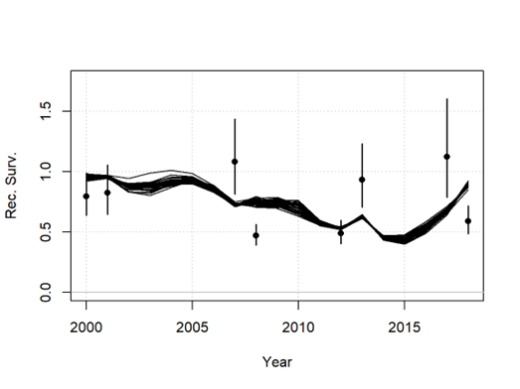
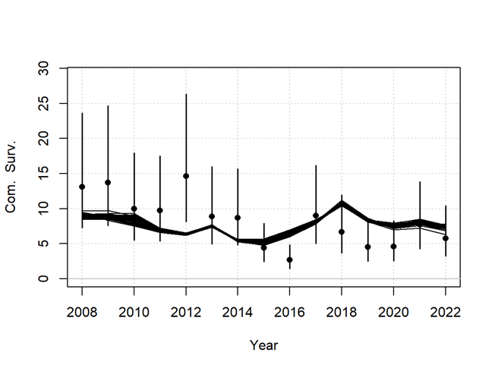
5. Model fit (SEC): Indices
Recreational standardized CPUE
Commercial nominal CPUE
How can Rec CPUE and Com. CPUE be improved?
Is there a proxy for F – e.g. days per habitat area?

Slide 22
5. Model fit (SEC): Recreational Survey (length and age)
Observed data
OM model fit
Is this indicative of recreational fishery selectivity?
SEC
SEC

Slide 23
5. Model fit (SEC): Historical Survey (length and age)
Observed data
OM model fit
Is this indicative of recreational fishery selectivity?
SEC
SEC

Slide 24
5. Model fit: Conclusions
CPUE Indices are preliminary and have issues
Catch fit is perfect (conditioned on catch) but perhaps should include uncertainty.
Fit to age composition data is excellent
Fit to length composition cannot currently approximate the width of the distribution (CV of length at age?).

Slide 25
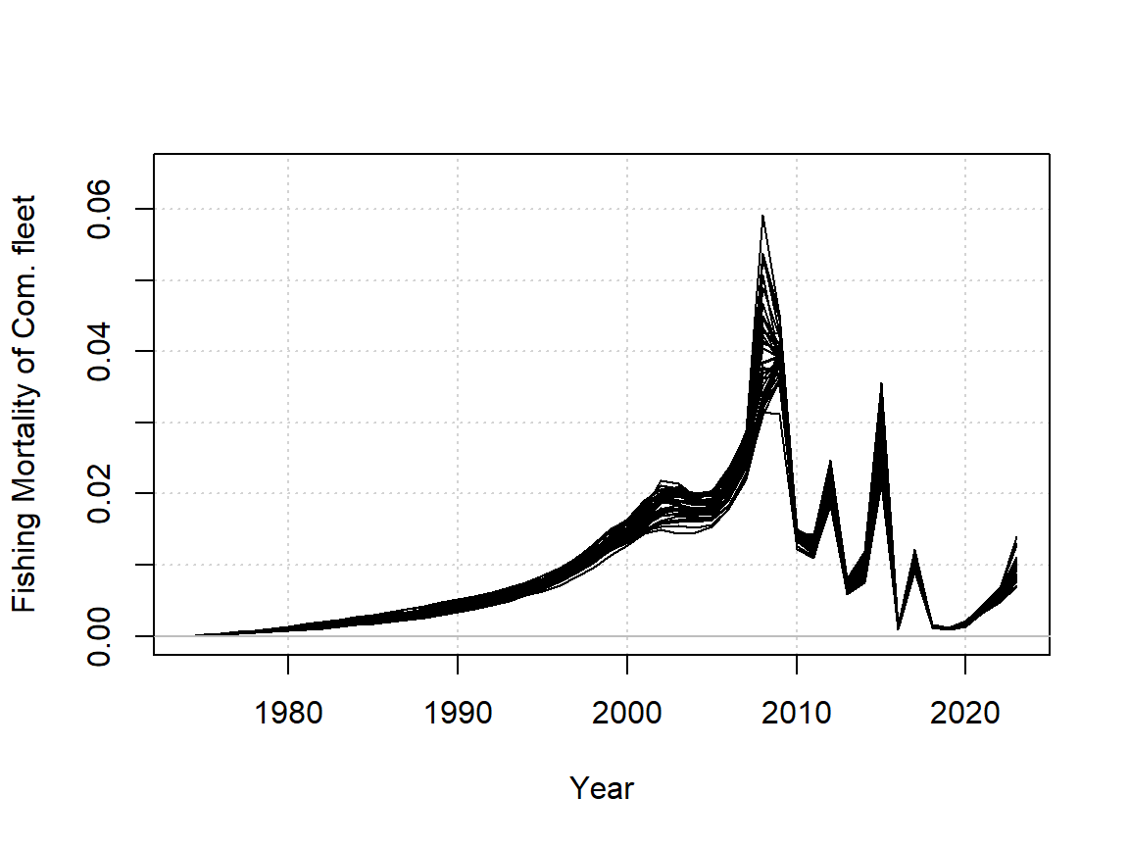
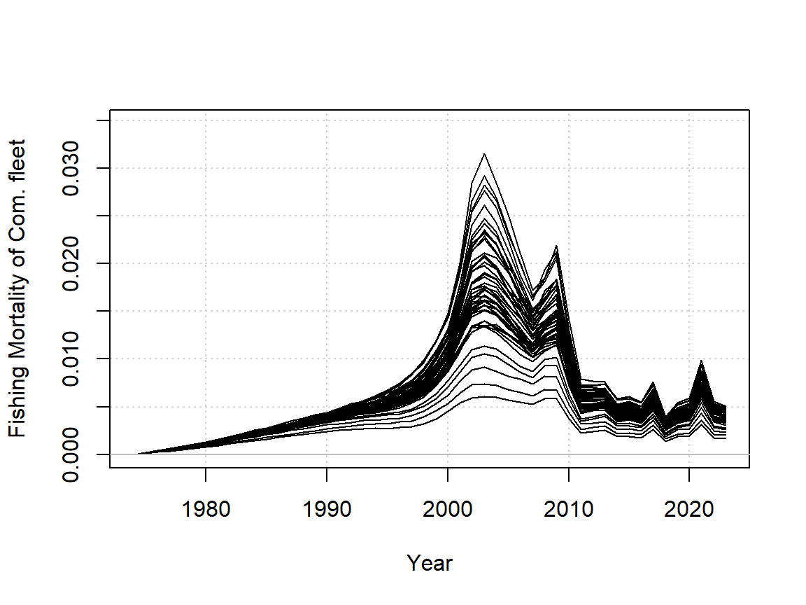
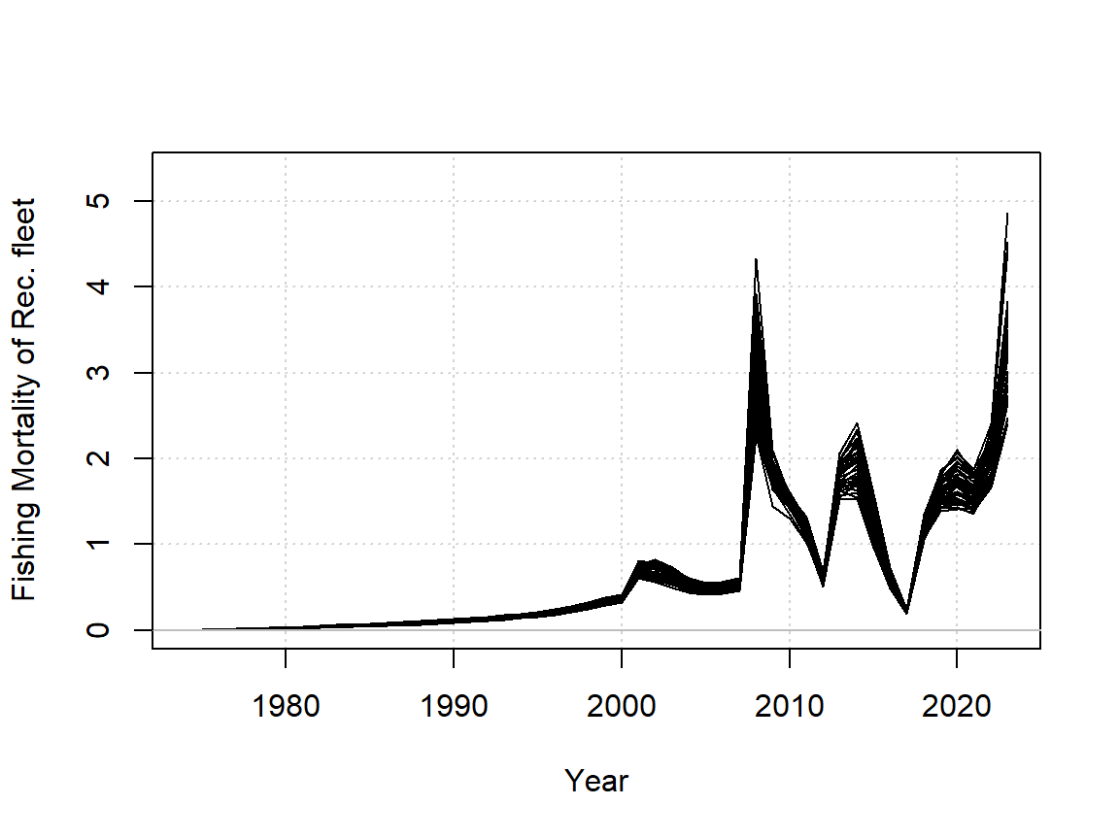
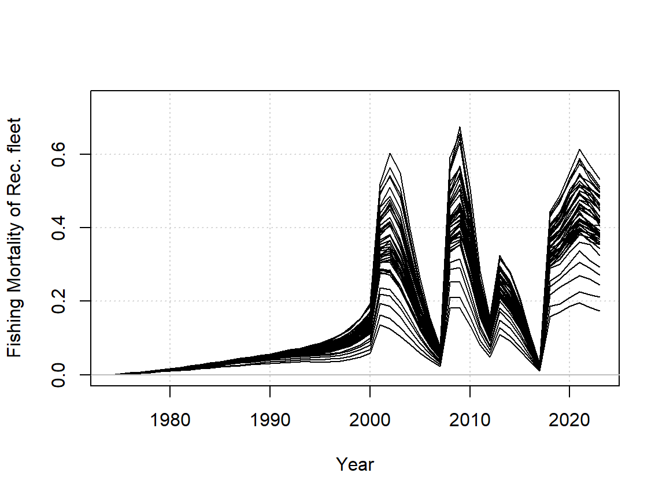
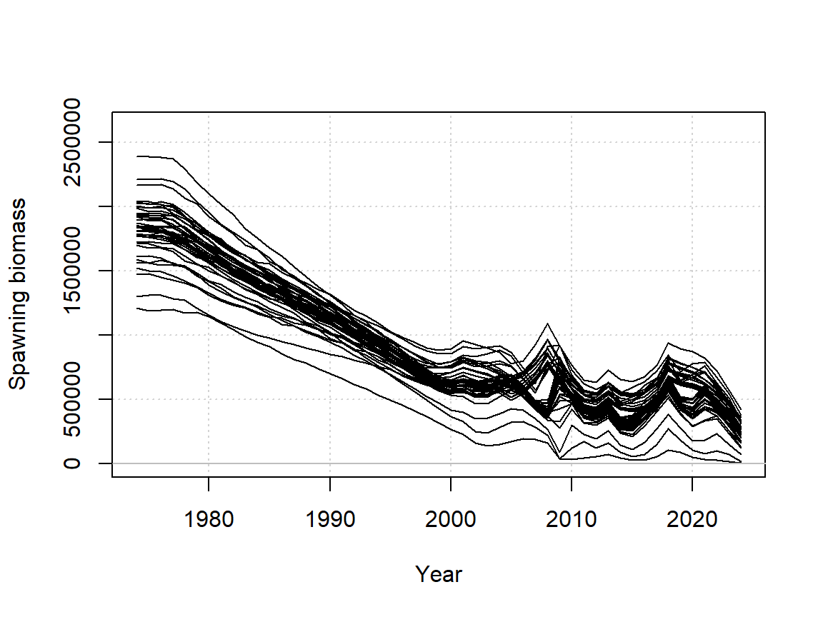
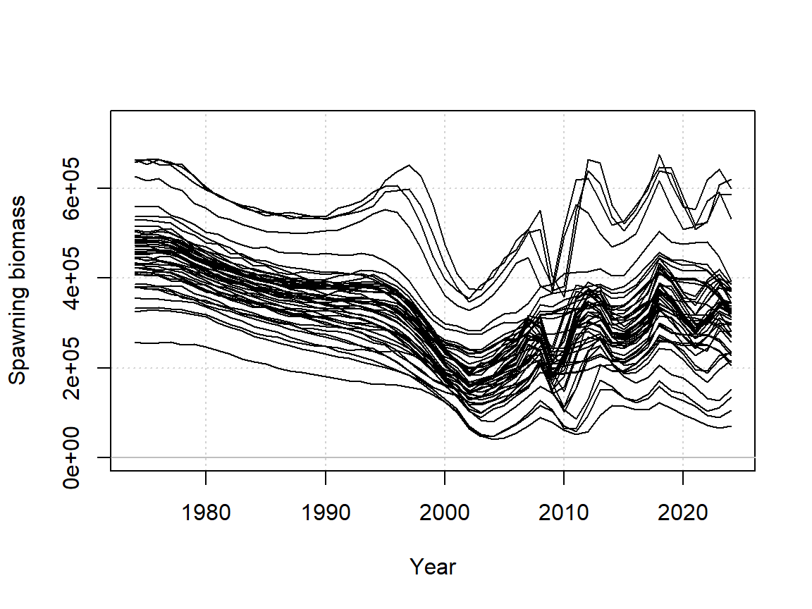
6. Model estimates: SSB & F
SEC
NEC

Slide 26
6. Model estimates: SSB & F
SEC
NEC
Very large differences in estimated recreational exploitation rate among SEC and NEC areas
Extremely high estimated exploitation rate of the recreational fleet in SEC
Exploitation rate more comparable among recreational and commercial fleets in the NEC
NEC a much smaller stock (unfished)
What outputs do you need (quantities, reference points)?

Slide 27
6. Next steps
Revise following feedback
Document assessment results
Include assessment diagnostics such as sensitivities, parameter profiles and retrospective analysis.
Develop example management procedures
Present preliminary closed-loop MSE-style simulation results

Slide 28
Acknowledgements
Thanks all for help getting to grips with this case study:
Sean Tracey, Nils Krueck, Kate Stark, Alyssa Marshall, Peter Coulson, Barrett Wolfe, Katie Cresswell, Ruth Sharples.

